Slide 1

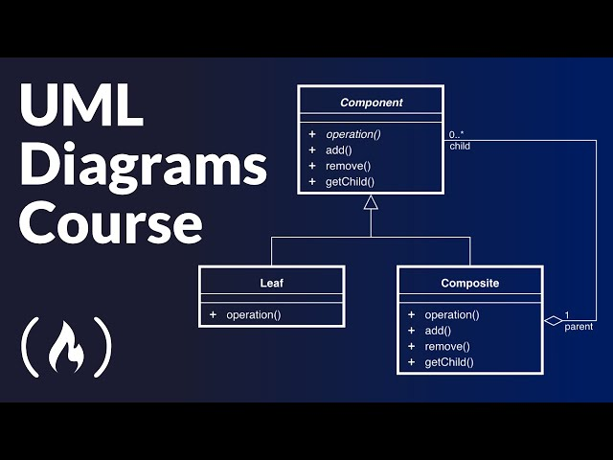

COS 214 Project (Git it done)
Git It Done

Slide 2
Meet the Team:
Joshua Heath
u23541475
Antony Van Straten
u24590739
Avuyile Sapula
u23540282
Hamdaan Mirza
u24631494
Dylan Hebron
U22503685
Abdelrahman Ahmed
U24898008
Abdulrahman Sabah
u24566179

Slide 3

Agenda:
Overview
Assumptions
Design Patterns With explanation
Bonus mark
Development Practices (github and unit testing)
Activity Diagram
Demo
Any questions ?

Slide 4
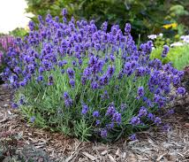


Overview
Customers request plants from cashier
3 Plant Types: Cactus, Lavender, Rose
Each plant uses its own Care Strategy
3 Staff Roles (Chain of Responsibility):
Greenhouse Manager → care strategy
Landscaper → plant states
Delivery Staff → delivery only
6 Plant States: Seedling, Growing, Dormant, Mature, Selling, Dead

Slide 5

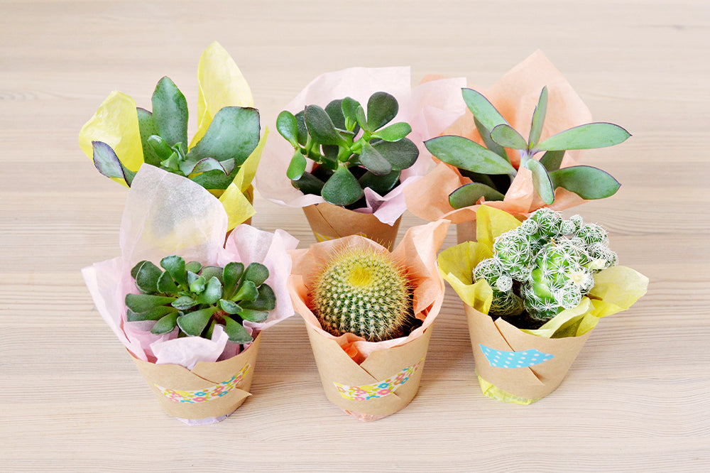
Assumptions:
The inventory will already be filled with plants before the system starts.
Staff members will check plant availability in the inventory before selling to customers.
The Front Desk will handle customer interactions, such as:
checking which plants the customer wants
confirming availability
sending the order to the correct staff member
When a delivery staff member takes plants to a customer:
they will ask the customer about decorations or any custom preferences
Plants in selling state will always be sold to the customer.
GUI
The GUI only shows plants that are currently in the Selling state.
The inventory in the GUI updates dynamically as plants are added, removed, or change state at runtime.

Slide 6

What design pattern we used
Prototype
Iterator
Decorator
Factory Method
Observer
Command
Strategy
State
Chain of responsibility
Mediator
Adapter

Slide 7
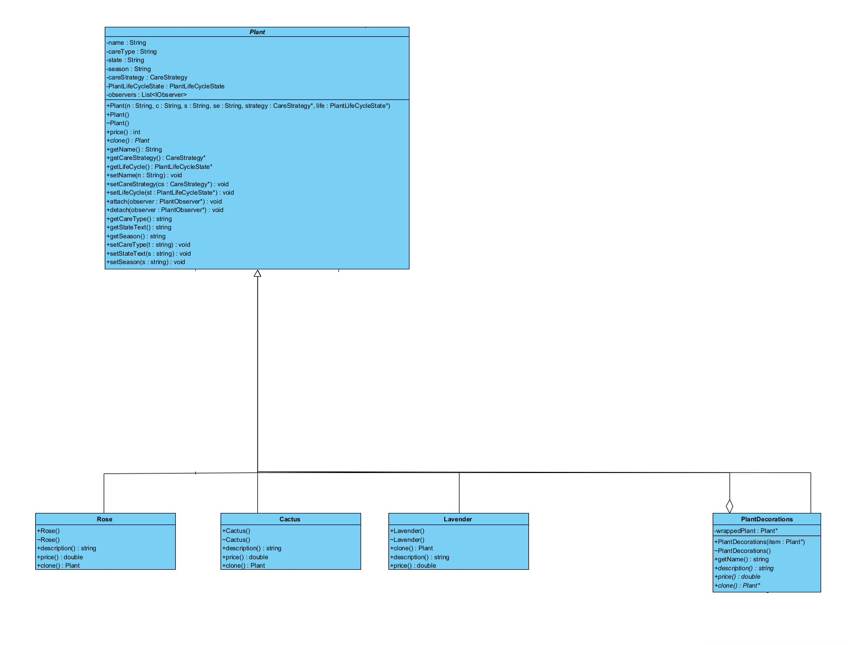
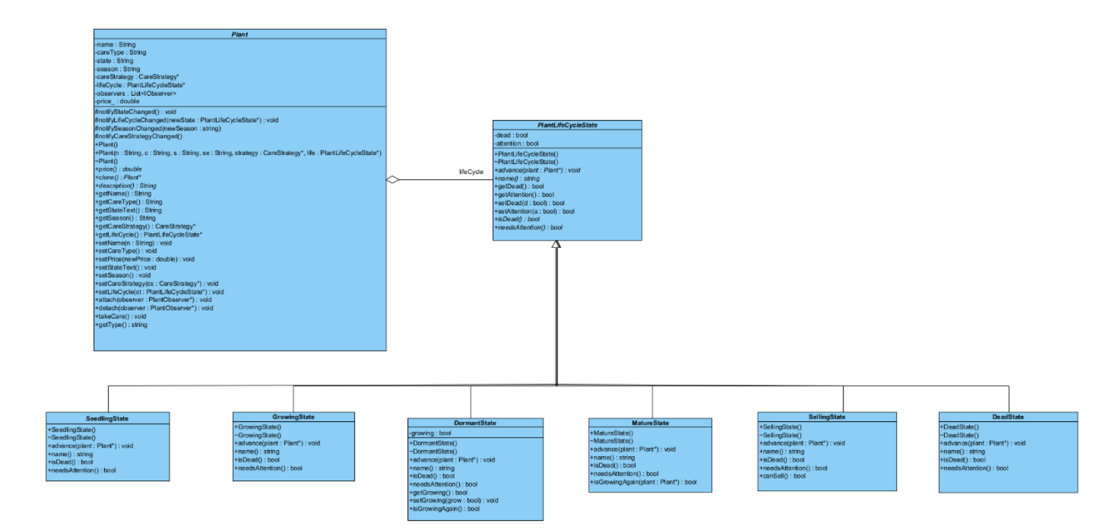
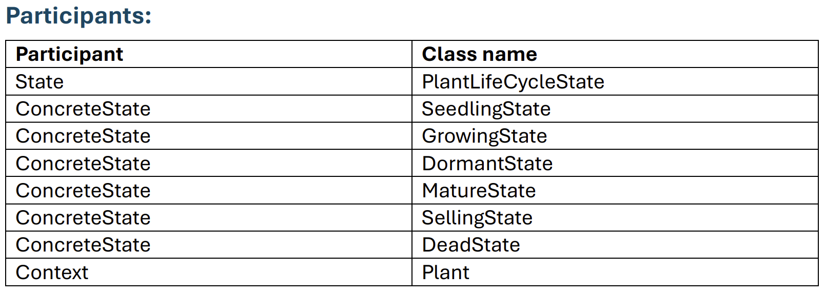
Prototype:
State – Hamdaan
(u24631494)

Slide 8
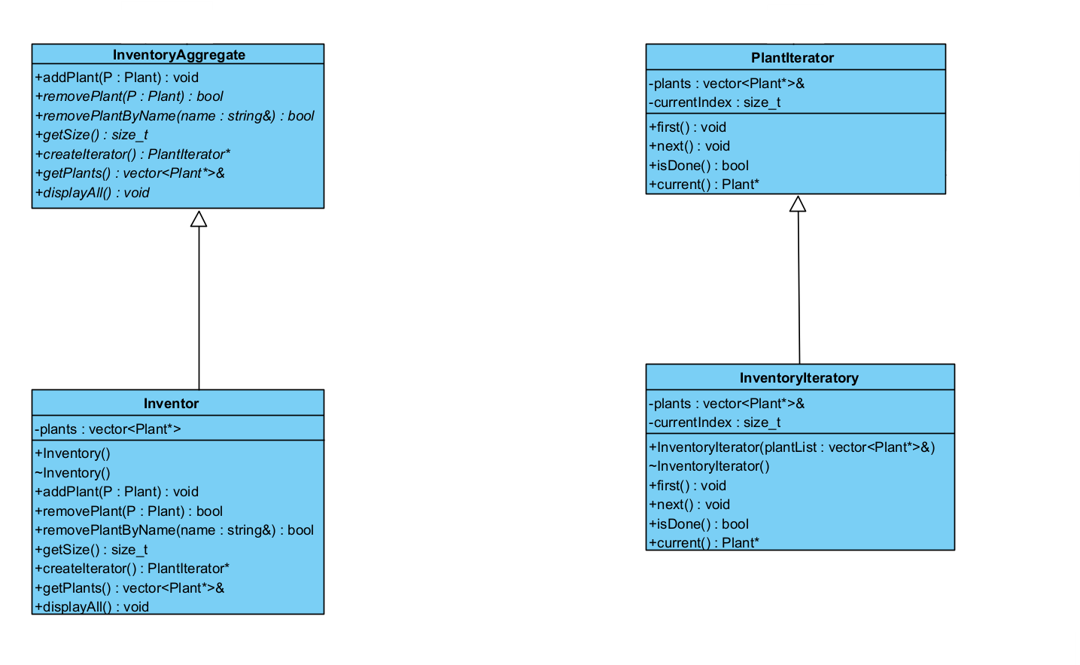
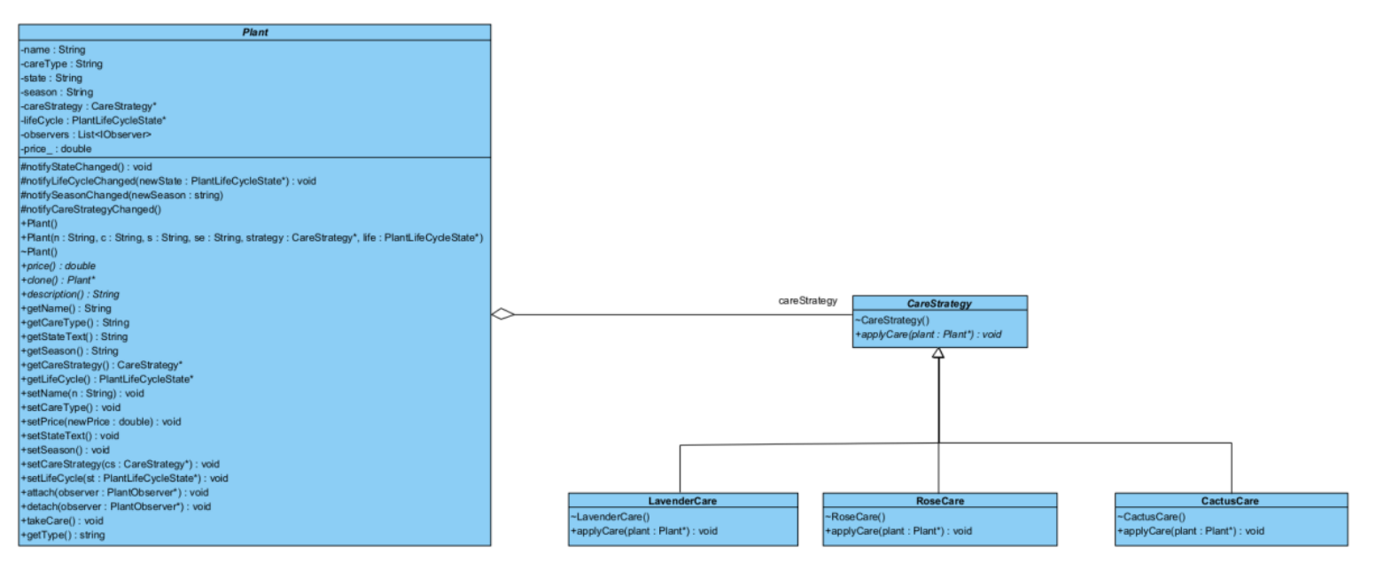
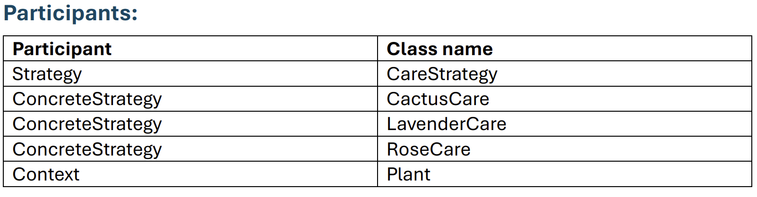
Iterator
Strategy – Abdelrahman (u24898008)

Slide 9
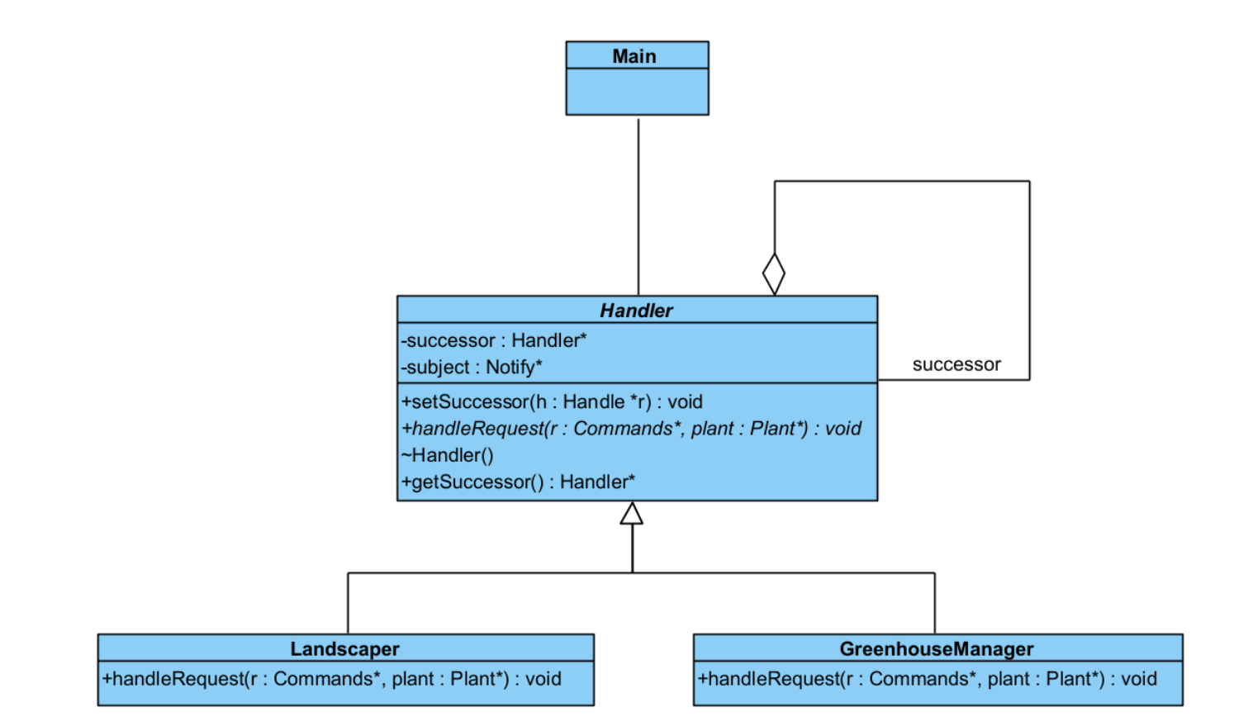
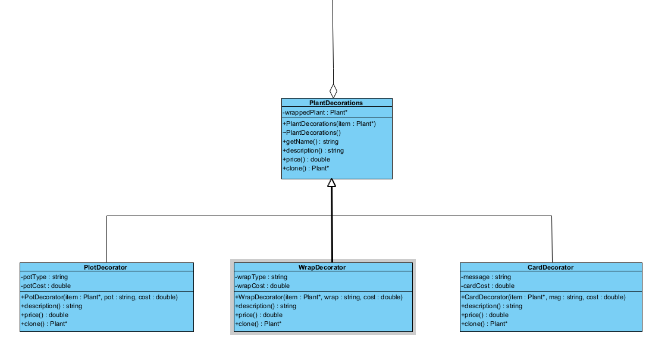
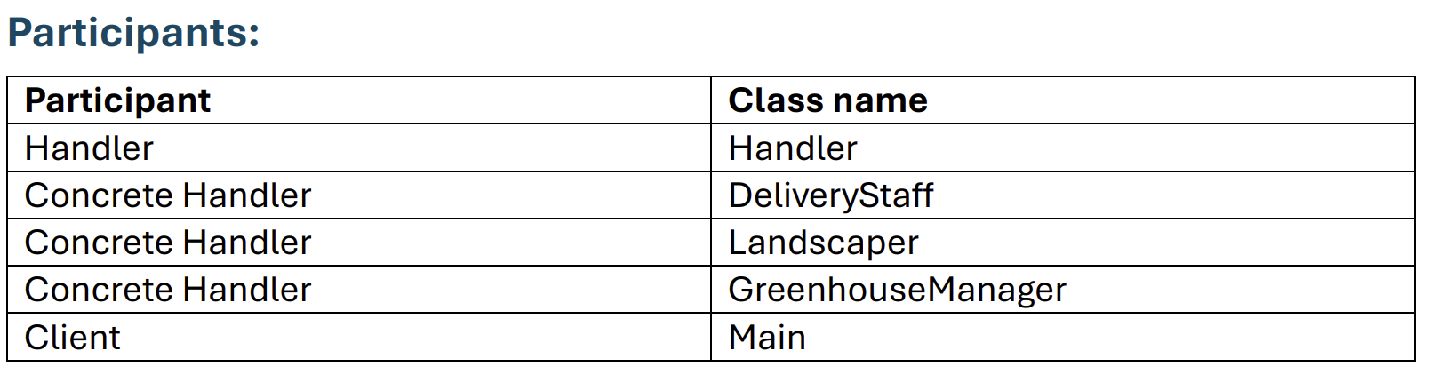
Decorator
Chain of responsibility – Antony
(u22503685)

Slide 10
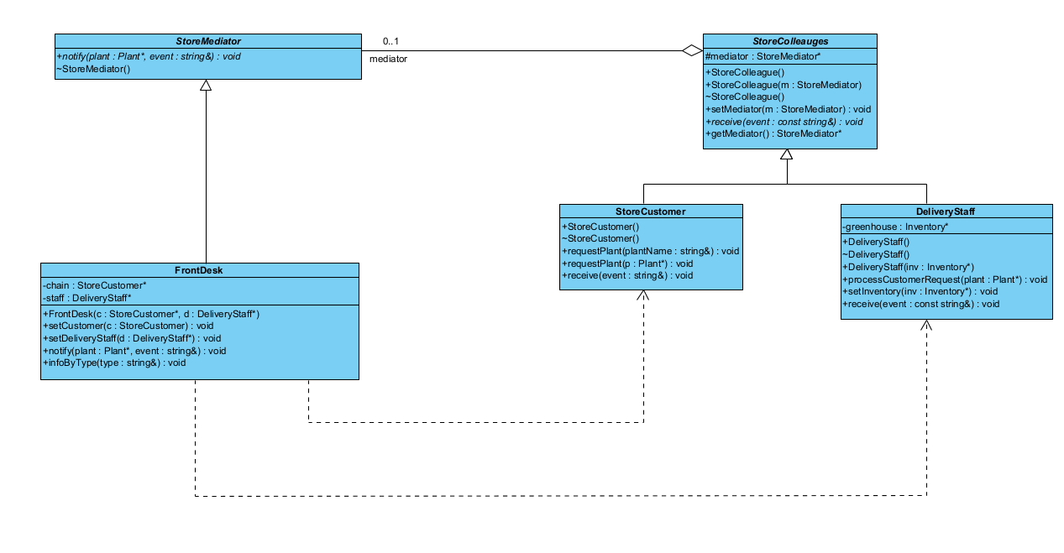
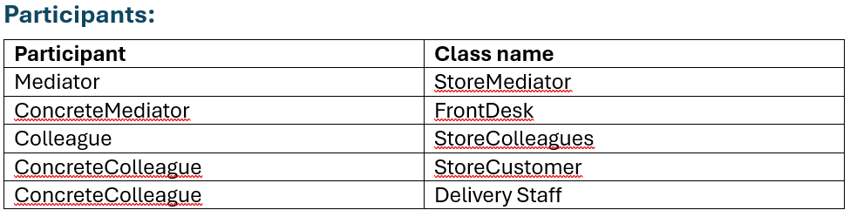
Factory
Mediator – Abdulrahman (u24566170)

Slide 11
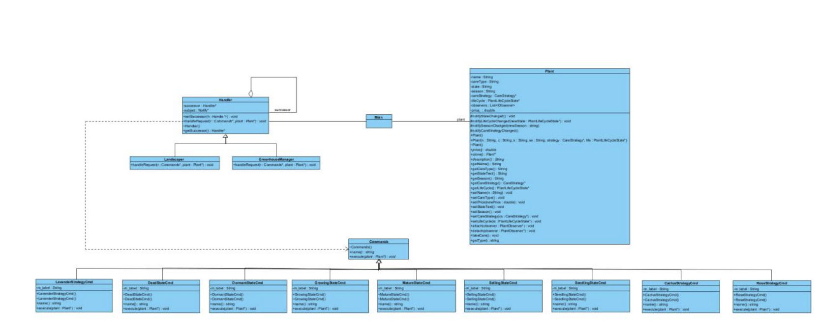
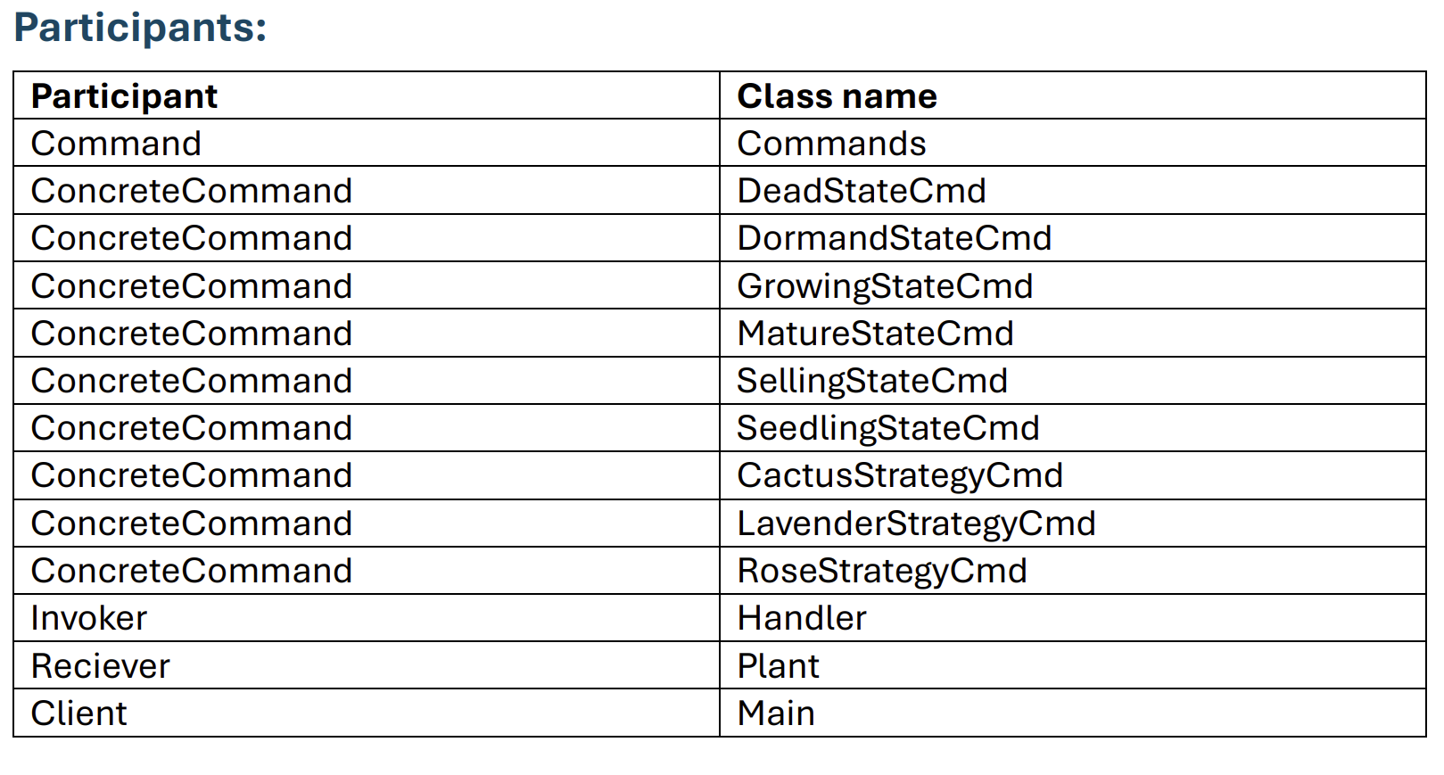
Observer
Command– Dylan
(u22503685)
Need Picture

Slide 12
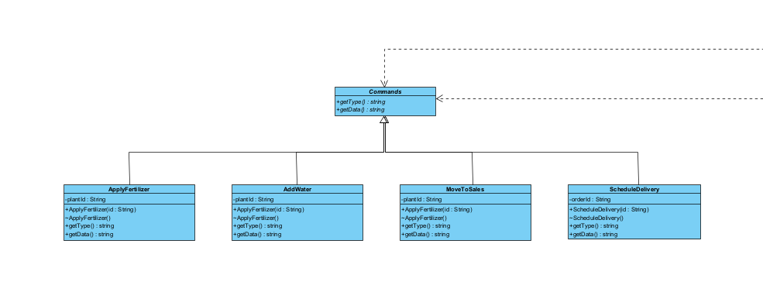
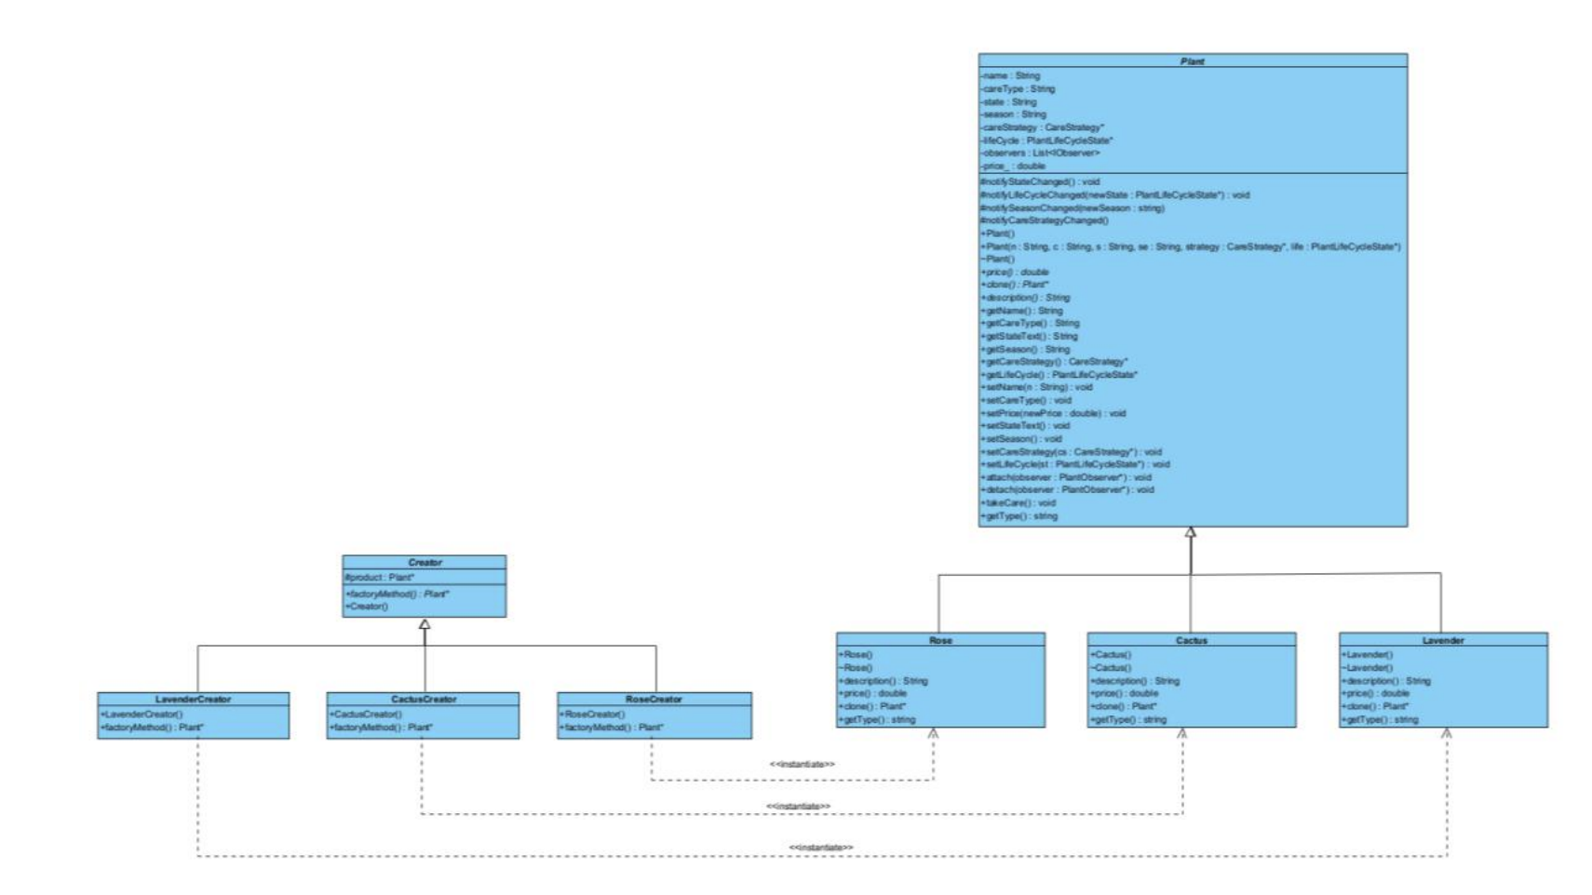
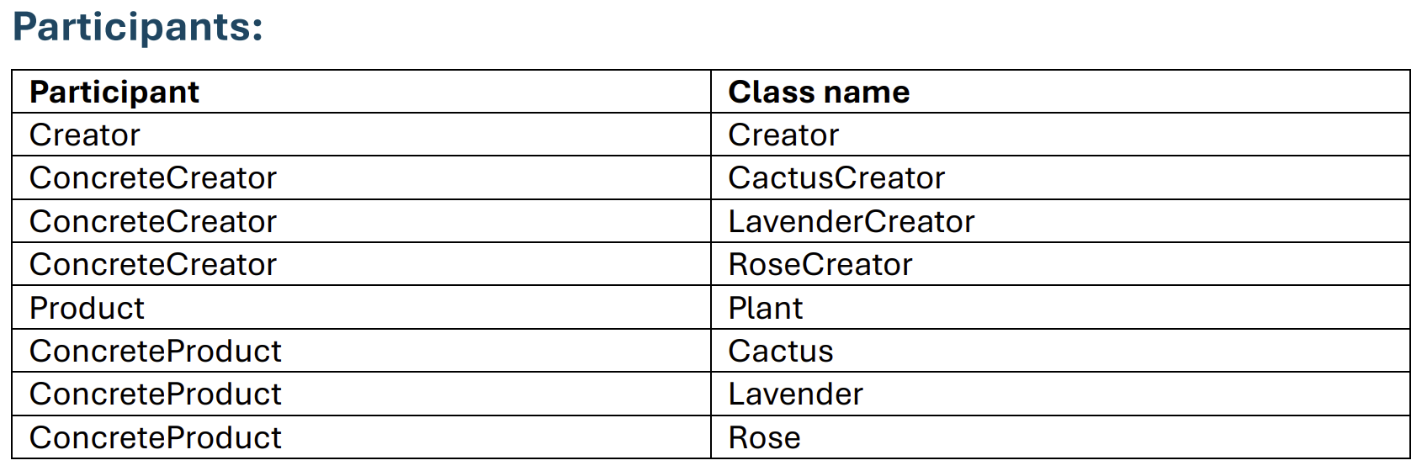
Command
Factory Method – Abdulrahman (u24566170)

Slide 13
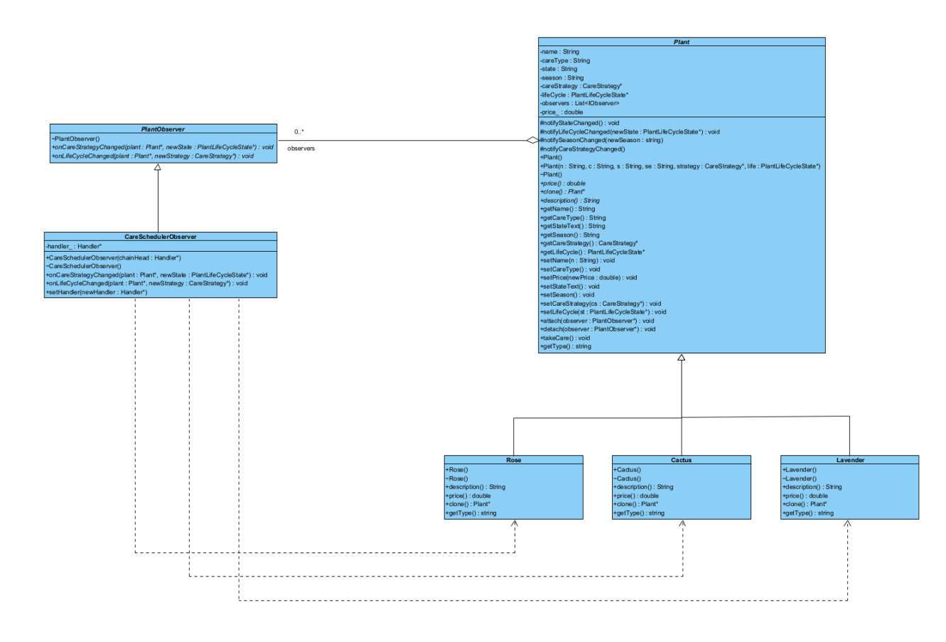
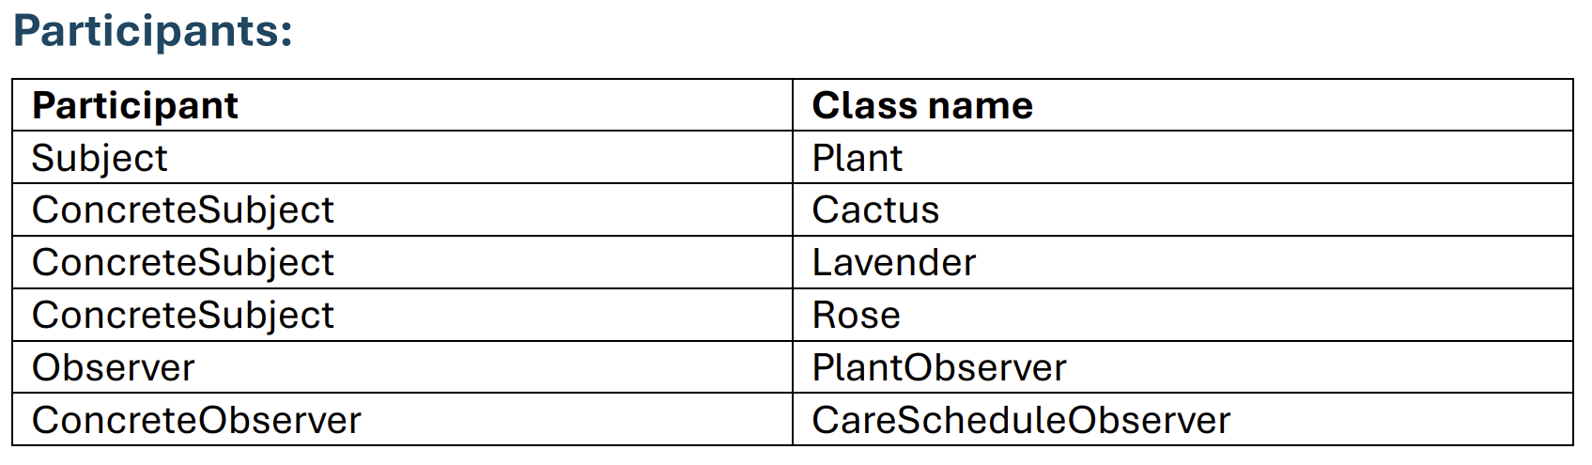
Observer - Avuyile
(u23540282)

Slide 14
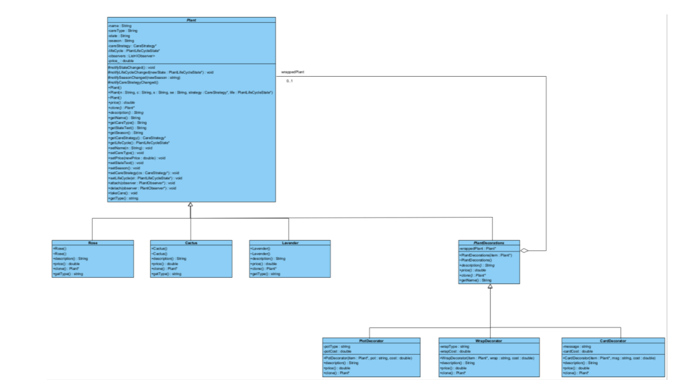
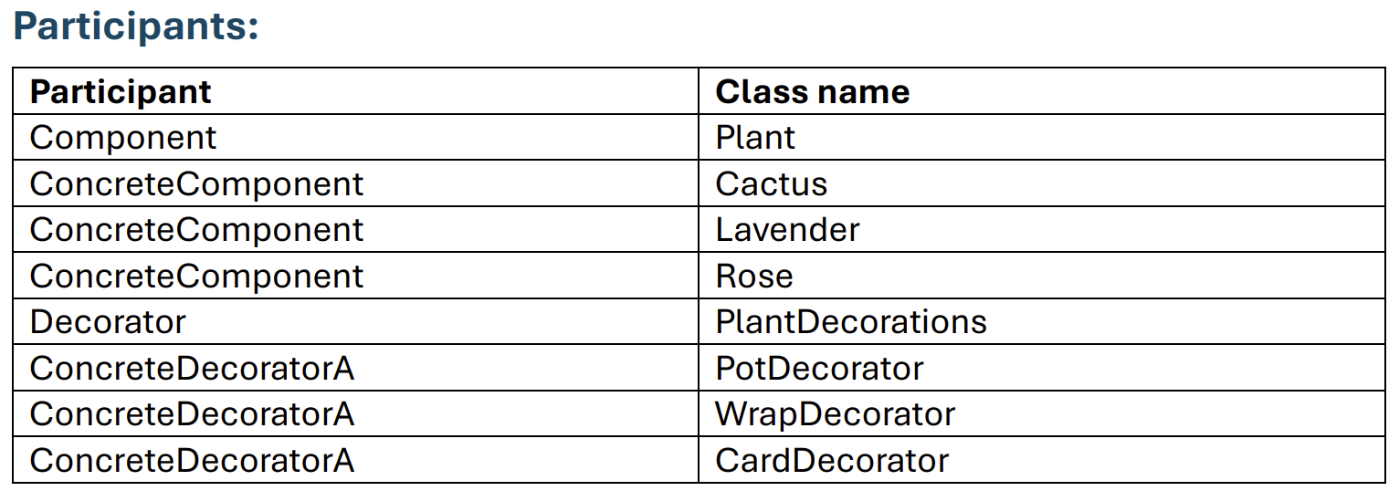
Command
Decorator - Avuyile
(u23540282)

Slide 15
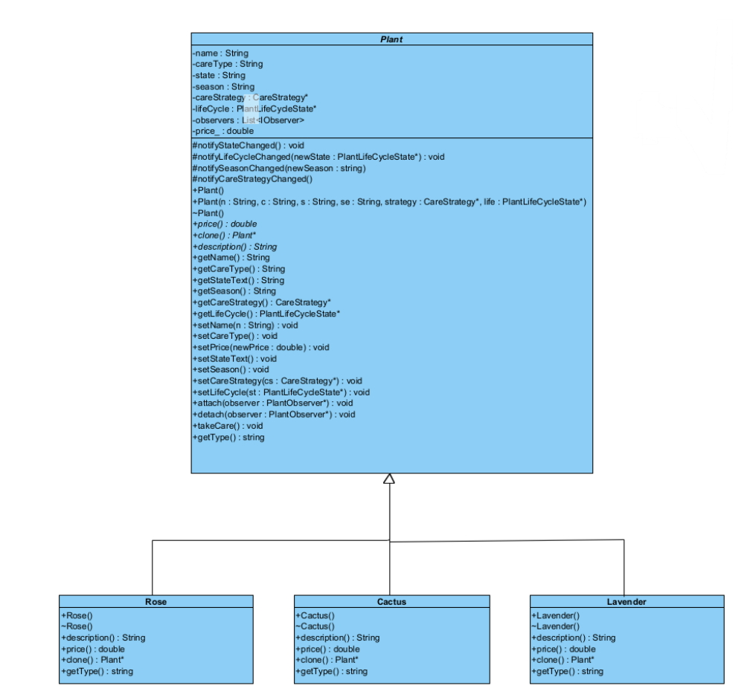
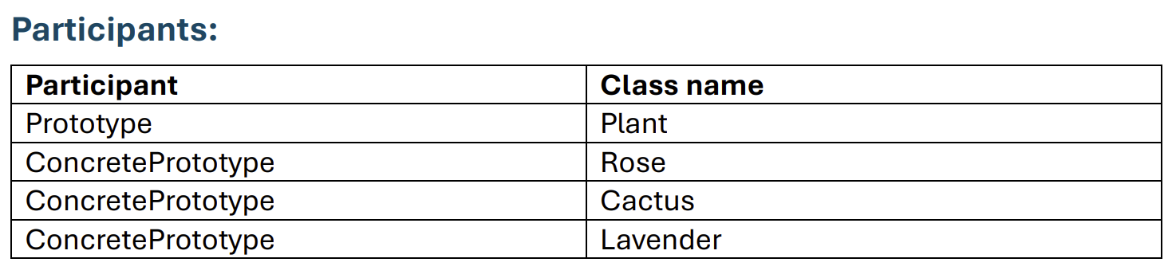
Command
Prototype – Antony
(u24590739)

Slide 16
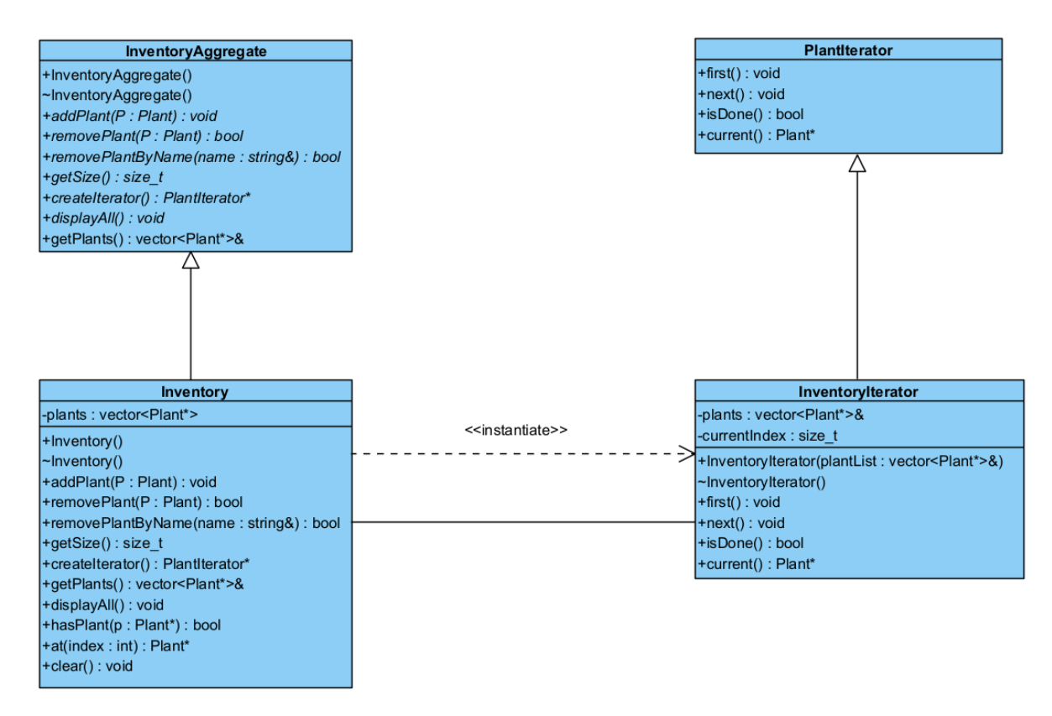
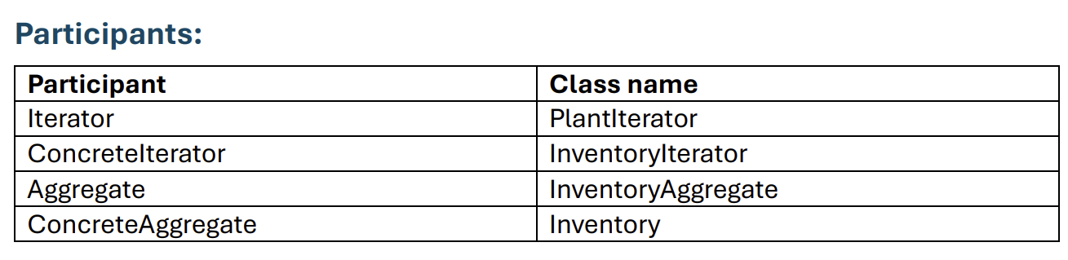
Iterator – Josh
(u23541475)

Slide 17
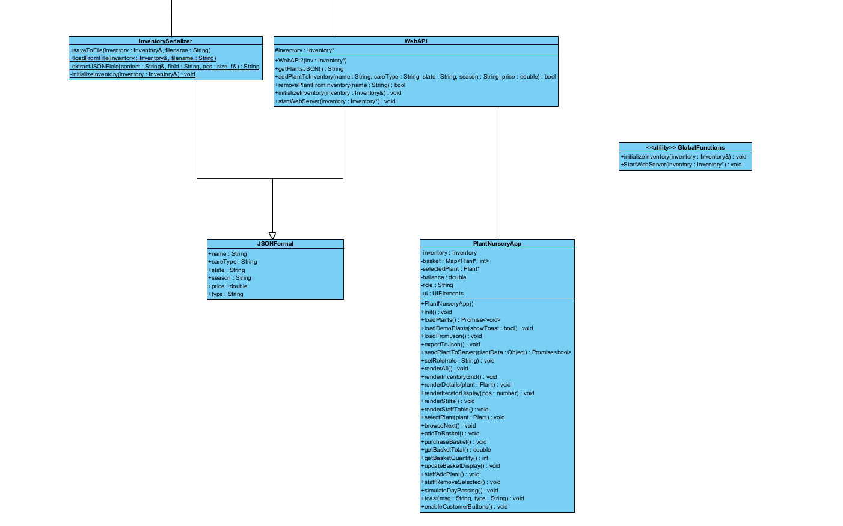
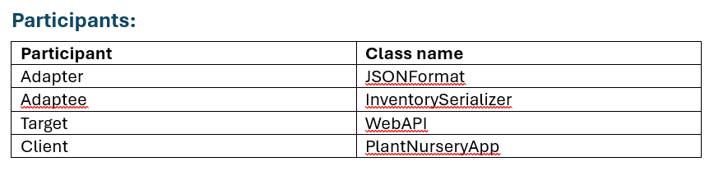
Josh (u23541475)
Adapter - Josh
(u23541475)

Slide 18


Bonus Marks
Created a simple GUI (will be shown in the presentation)
Implemented GitHub Actions for automated linting and testing

Slide 19
Version Control with Git
We used a secondary testing main before merging to main
1
Each member developed their own design pattern independently
2
All patterns were merged into the secondary main for testing together
3
When patterns were linked, team members reviewed and added comments where needed
4
We fixed issues and improved code before final merging
5
Merge conflicts were resolved collaboratively
6

Slide 20

Unit testing
We used the doctest framework.
It was organised such that each design pattern had its own file(testFile folder)
We tested state transitions in state design pattern, mediator interactions etc.
We made sure all our tests passed
We ran valgrind to ensure no memory leaks.

Slide 21

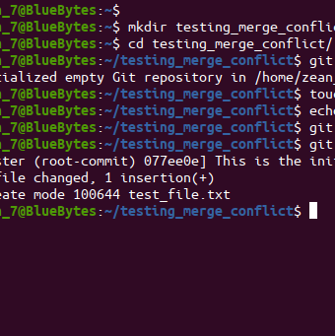
Conflict
We had no conflict and we meet regular to see what had to be done every Monday we meet and discussed on the whatsapp group what we had to do but overall all the works was distrubted evenly and majority of the meeting was to just sort merge conflict

Slide 22
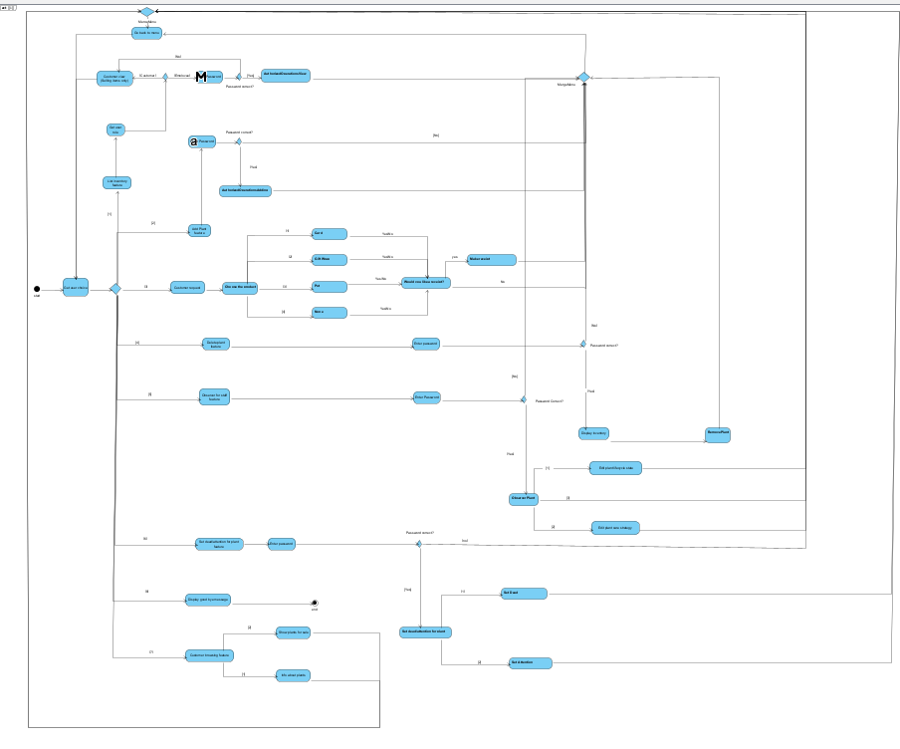

Slide 23

Demo time

Slide 24
Thank you
Thank you and hope you enjoyed our demo
Any Question

